Slide 1
“Document Archive”
Information and Search System

Slide 2
Key features
Download documents from different sources
Extracting text from different file formats
Finding the main and additional language of documents
Translation documents
Full text indexing in different languages
Document rubrication
Search Objects Monitoring in documents
Analysis of documents in various slices of the
Timeline Scale Export documents to external systems

Slide 3
Download documents
Sources
File formats
Internet
Organization's network folders
Special folder on the server
Customer apps
Third-party systems through API systems
Word (doc, docx)
Excel (xls, xlsx)
Adobe Reader (pdf)
Text (txt) – Automatic coding definition
HTML

Slide 4
Search for documents by
Content - full-text search
Source of information
Country of source
Entity of monitoring
Rubric of documents
Rubric of sources
Date of publication
Language of documents
Date of loaded

Slide 5
Automatic rubric
A rubric in the form of a tree
Several key phrases are defined for each branch
Each phrase can be translated into several languages
  Crime
  Criminal offences
  Financial crimes
  Corruption
      Bribe
      Bribery
Language | Translate
Russian | Коррупция
English | Corruption
Chinese | 腐敗
Arabic | فساد

Slide 6
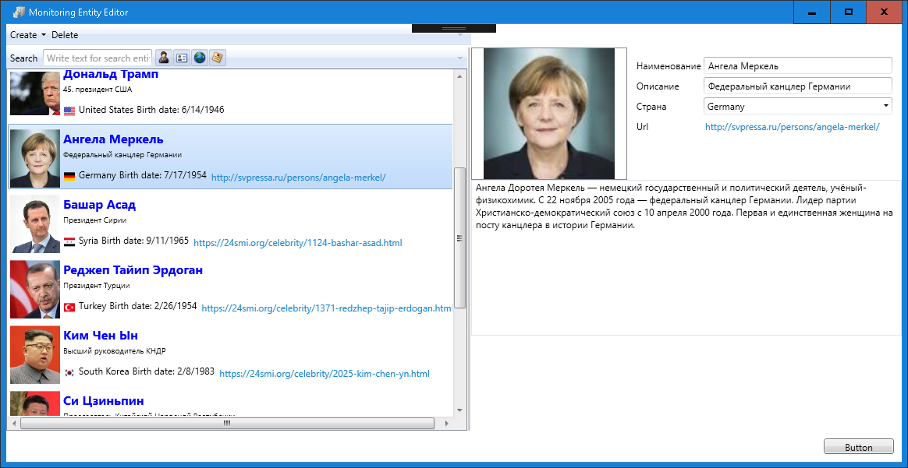
Monitoring facilities
Type
Characteristics
Person
Organization
Region
Concept
Name
Synonyms in several languagesКраткая информация
Dossier
Photo/logo
Date of birth (for persons)

Slide 7
Request stats
Statistics by country of sources
Statistics by language of documents
Statistics by sources
Statistics on the rubric of documents
Statistics on the rubric of sources
Statistics on monitoring objects

Slide 8
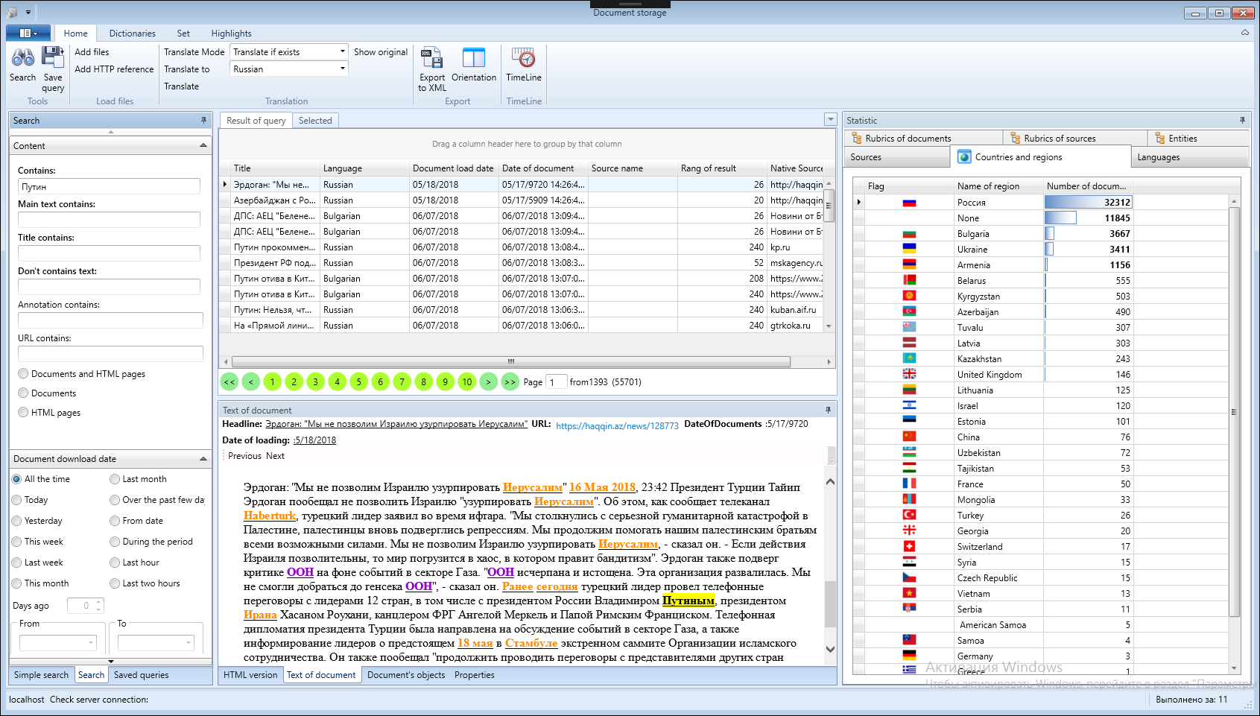
Statistics of documents by region of sources

Slide 9
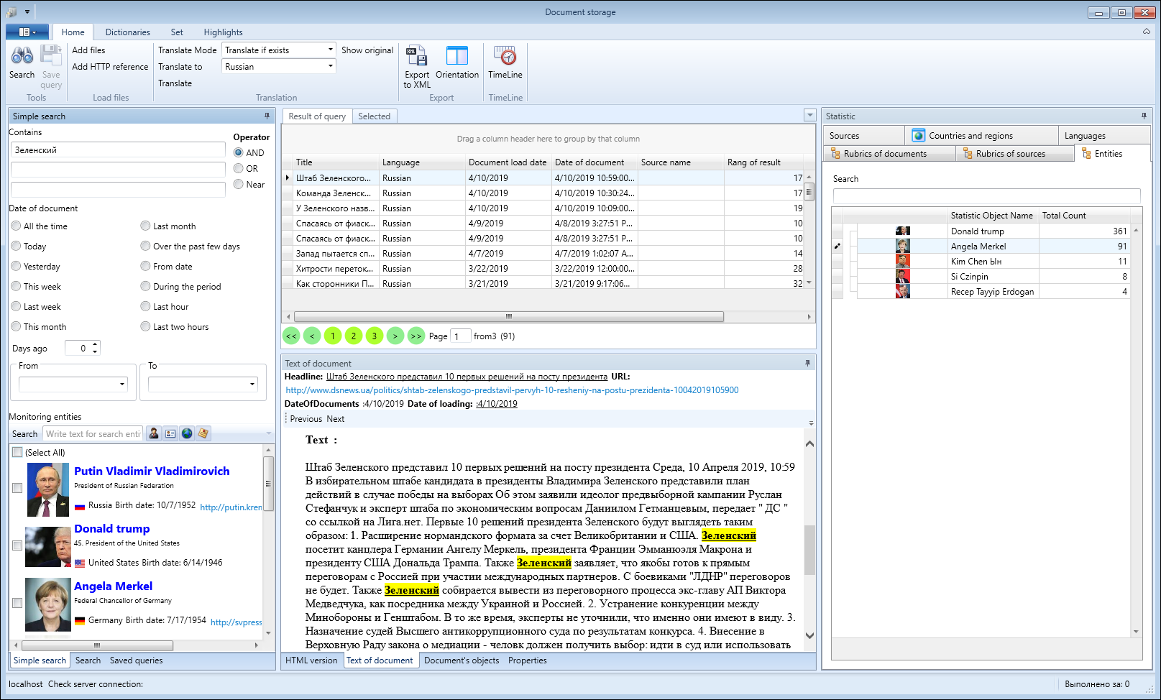
Document statistics on monitoring sites

Slide 10
View document text
Showing text
Show the original document
  Show translation if you have.
    Shows a translation of the text, if it is already in the database.
  Translate automatically
    The translation will be made automatically into the chosen language using Google translator.
    Translation is stored in the database
Text illumination
  The phrase you're not in different languages
  Monitoring objects in different languages
  Keywords in different languages

Slide 11
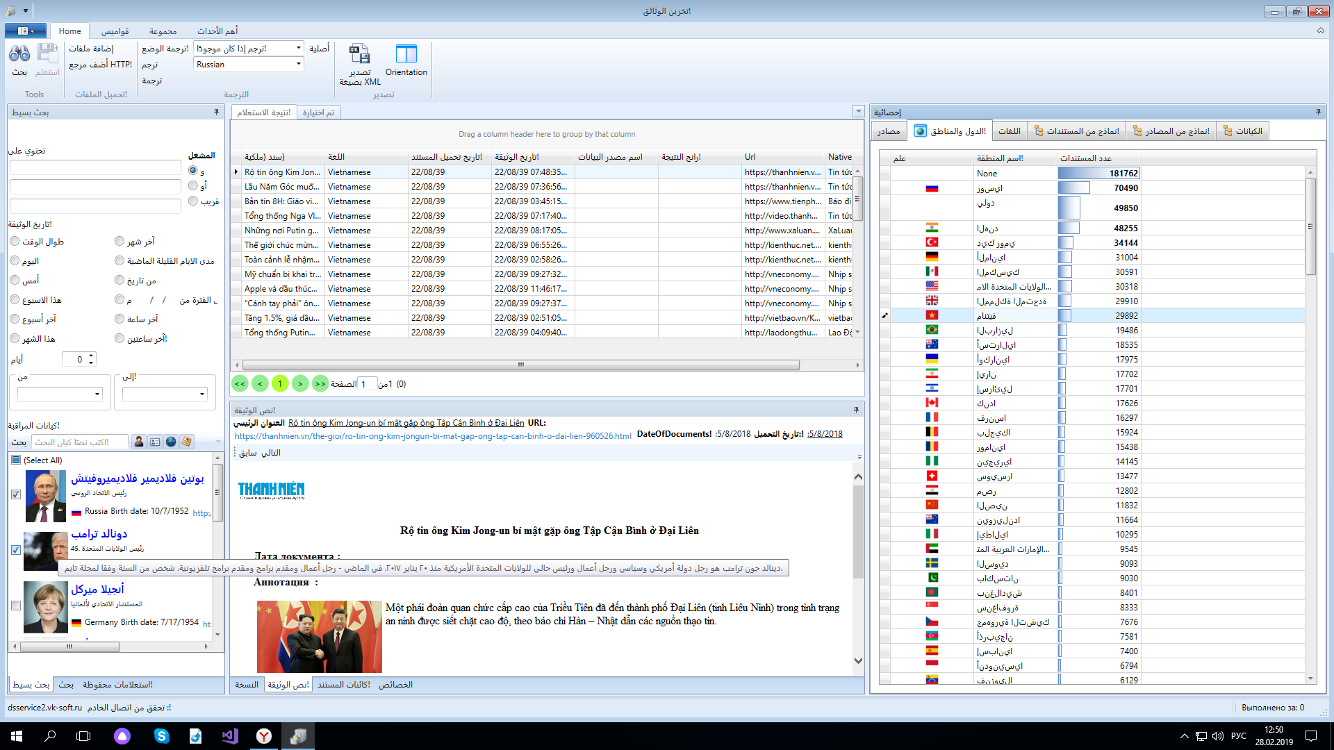
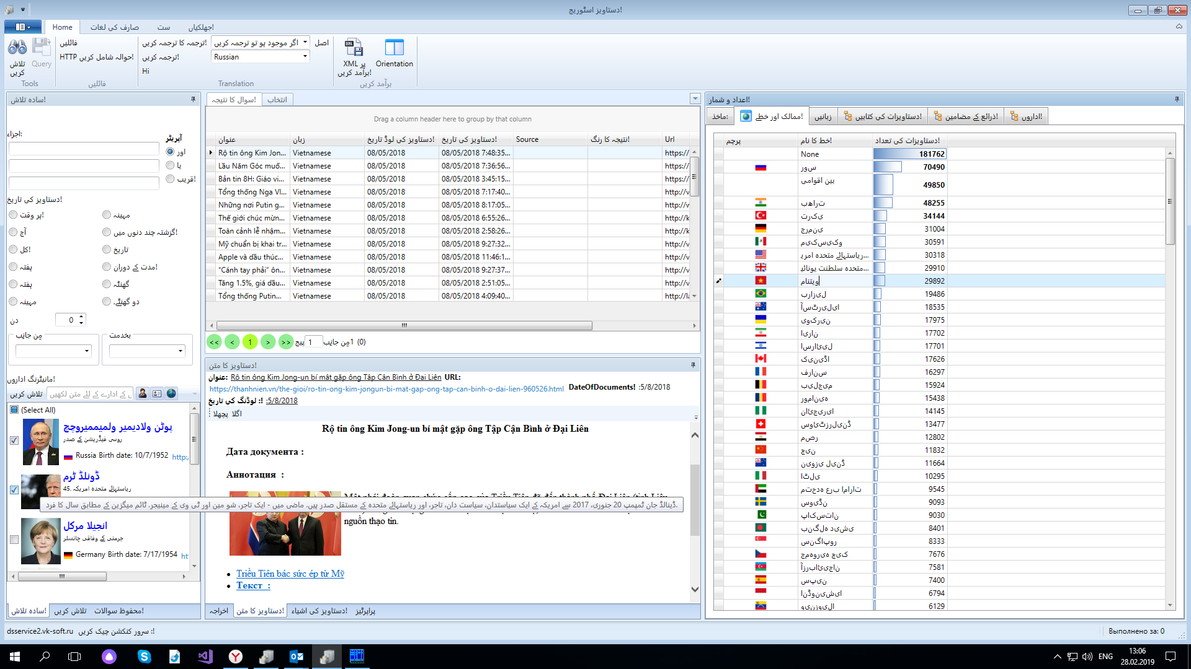
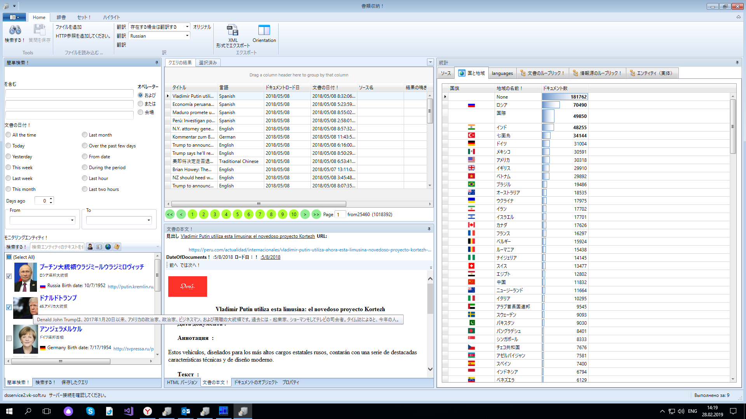
Localization
Localization of both interface and data in multiple languages at the same time.

Slide 12
Automatic removal of objects from texts
In the background, objects are extracted from Text (in the current version only on Russian)
Types of objects recovered
  Persons
  Organizations
  Countries и regions
  E-Mails
  Names of your own
  Dates and amounts
  Phone numbers, Tax-ID etc.

Slide 13
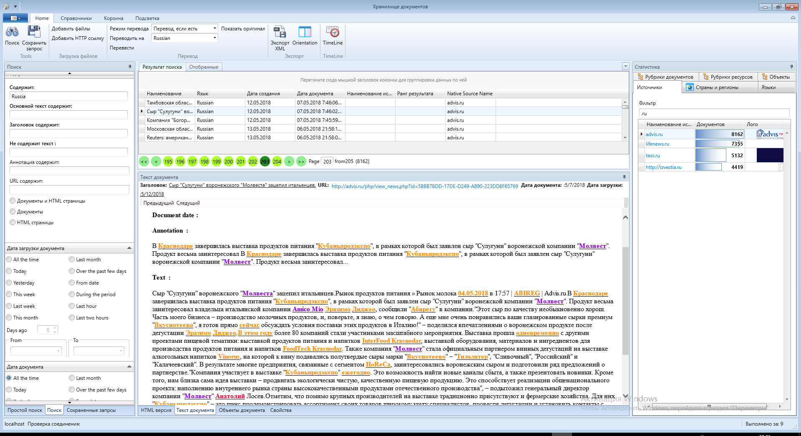
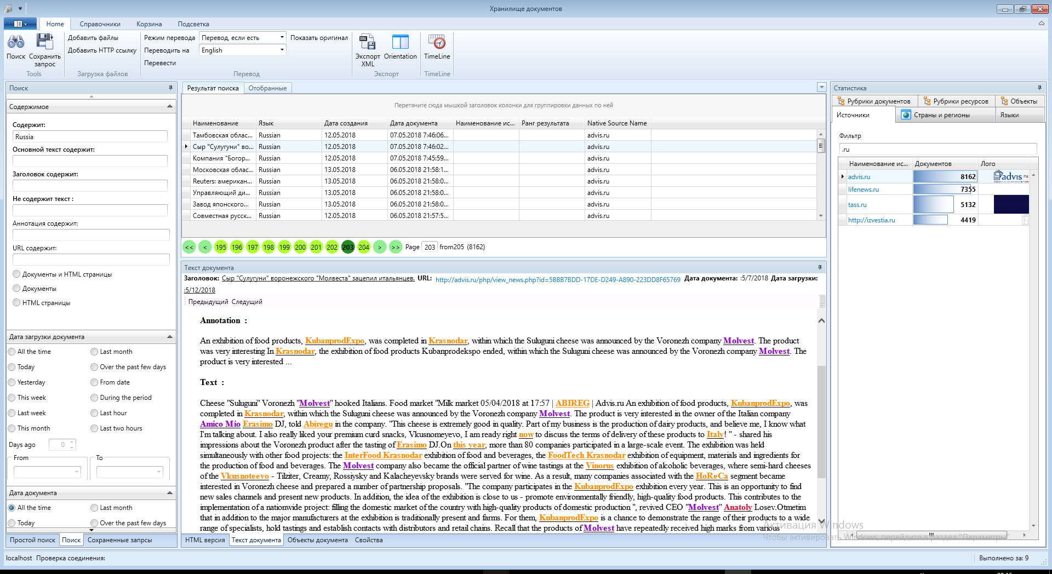
Illumination of objects and keywords in the original
аnd in translation

Slide 14
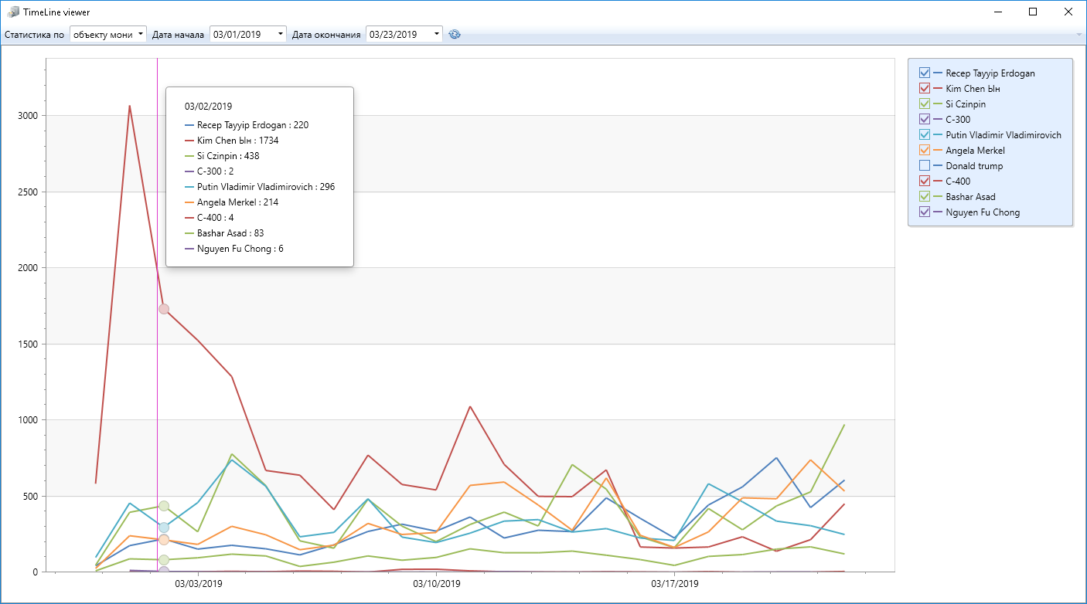
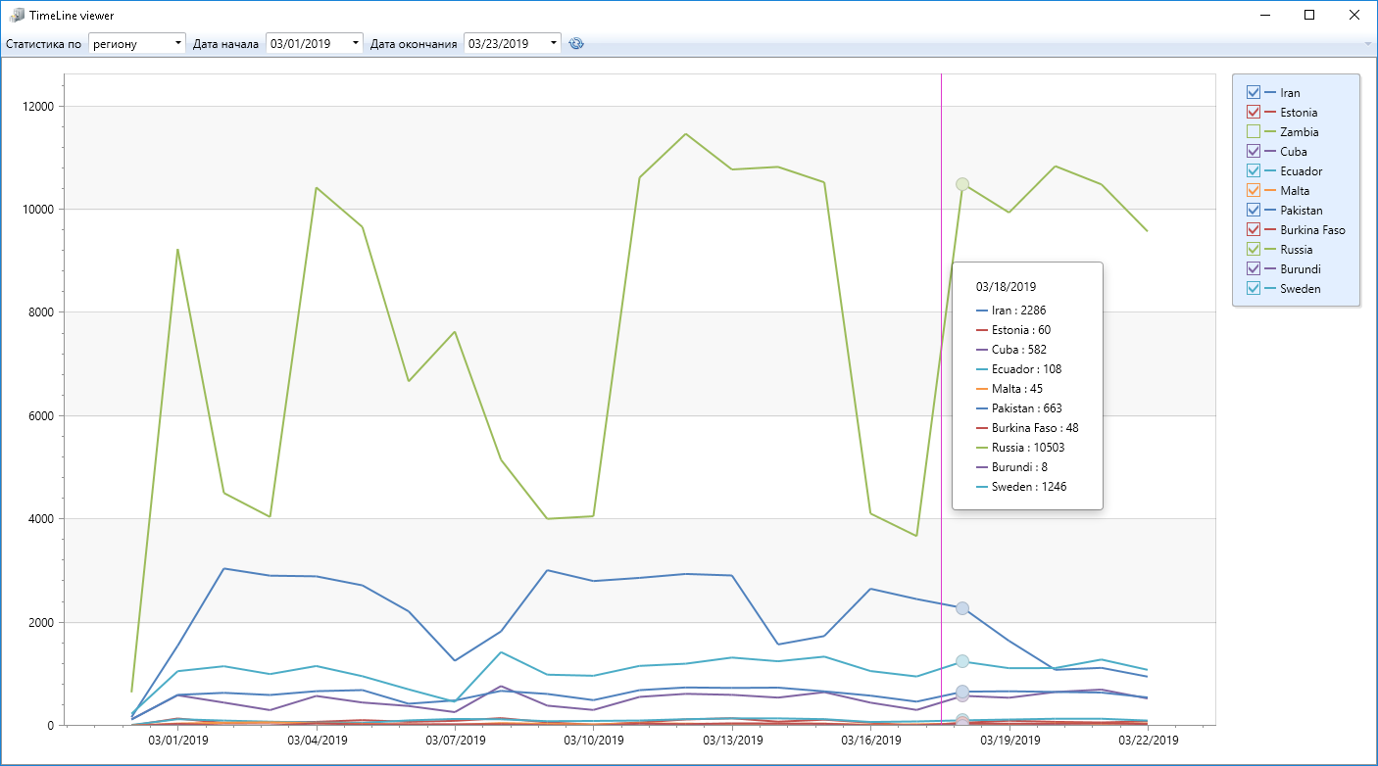
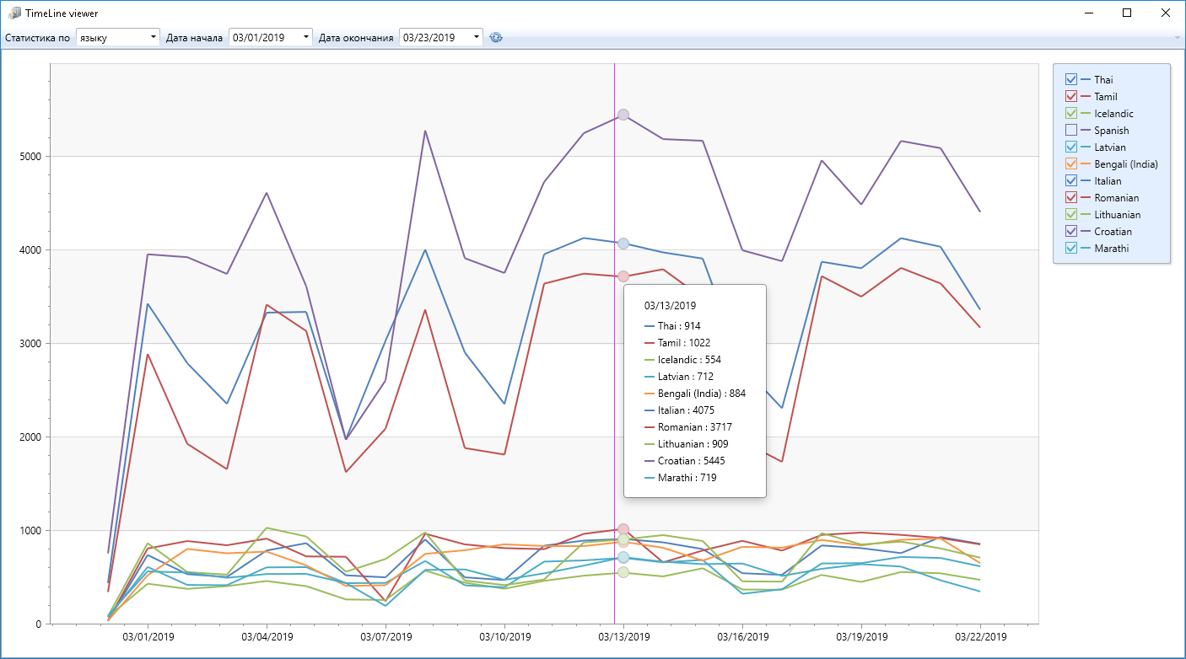
Timeline.
Number of documents per date on different slices
By monitoring object
By source region
By document language
By :
Rubric of source
Rubric of document’s Source
Source

